Slide 1
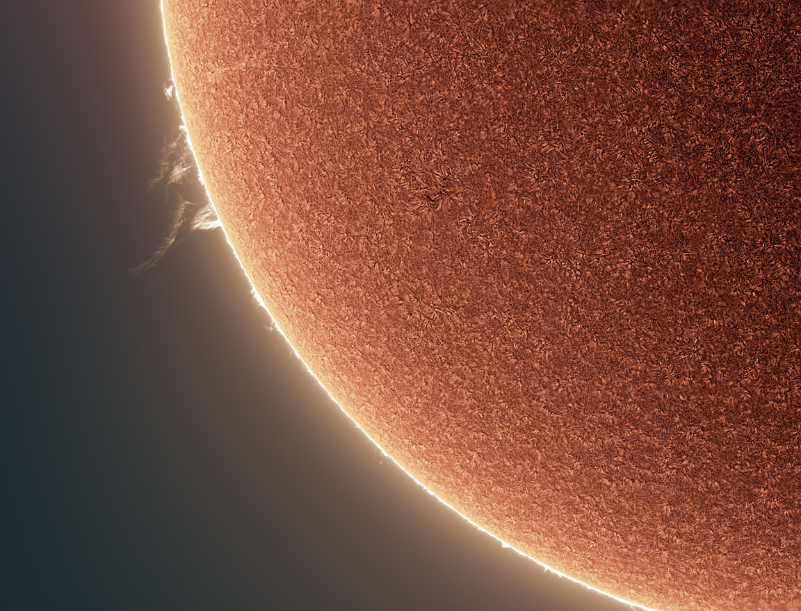
Welcome to Section 3:
Exploring Pinhole Projection with Your Own Hands
NASA PUNCH website: https://punch.space.swri.edu /
Scan here to access all PUNCH Outreach products or visit:
https://punch.space.swri.edu/punch_outreach_products.php
For questions or to request our 1-page monthly newsletter: Contact PUNCHOutreach@gmail.com
Photo: Alan Friedman

Slide 2
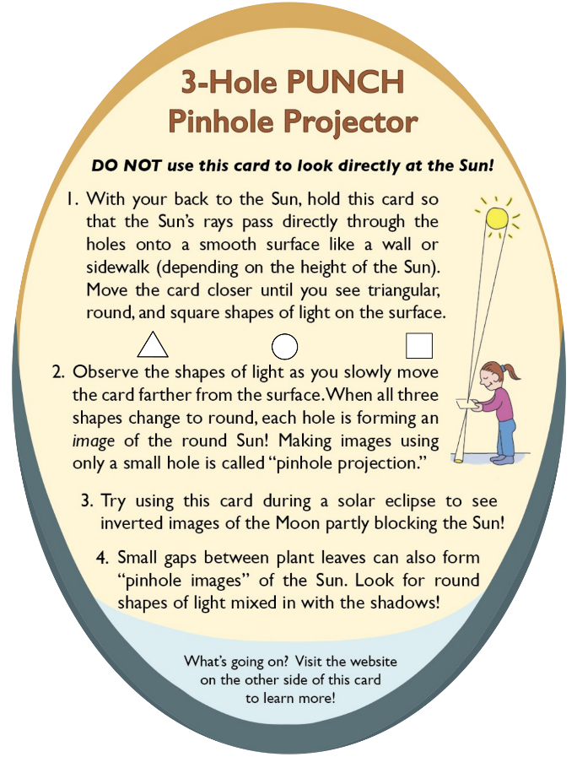
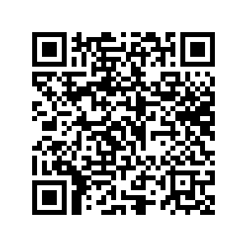
[Really] Understanding Pinhole Projection of the Sun
Outreach for the NASA PUNCH mission
Follow along with our playful learning adventure!
And PLEASE give us feedback on these questions at the link below:
Insights gained?
Remaining questions?
Ideas for improvements?
​https://tinyurl.com/PinholeFeedback
MARK 3 Version
Final Release for use up to and including the Annular Eclipse on 14 Oct 2023
FRONT
BACK

Slide 3
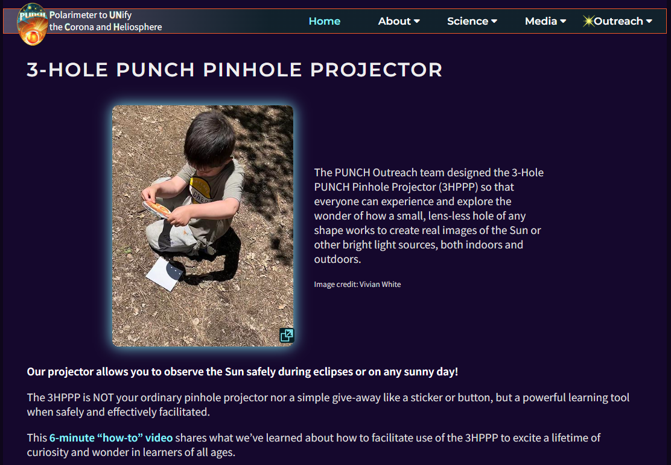
Essential viewing: 6-minute “how-to-facilitate” video [ https://punch.space.swri.edu/punch_outreach_pinholeprojector.php ]
Outreach for the NASA PUNCH mission

Slide 4
[Really] Understanding Pinhole Projection of the Sun
Introducing Bhanu
[BAH-noo]
Bhanu means
“ray of light”
in Sanskrit
Outreach for the NASA PUNCH mission
Bhanu helps guide our way through these Sections. You are in Section 3 of 5.
Section | Title of Section | Description of Section
1 | How to Use the 3-Hole PUNCH Pinhole Projector | introduces the 3-Hole PUNCH Pinhole Projector, demonstrates how to use it both outdoors and indoors, and describes its differences from a pinhole camera/viewer.
2 | Observing Pinhole Images of the Sun in Our Everyday Environments | teaches you how to observe the phenomenon of pinhole images of the Sun in our everyday world, both indoors and outdoors.
3 | Exploring Pinhole Projection Using Your Own Hands | invites you to explore the behavior of pinhole projection by experimenting with your own hands (try both palms up!)
4 | Explaining and Understanding How Pinhole Imaging Happens | interactively guides your quest for explanations and deeper understanding of how pinhole imaging happens. After this, you will really understand why small, lens-less holes can create images.
5 | APPENDICES A-E: More Insights & Fun Resources | offers more insights & resources (e.g., explaining the relationship between pinhole images and the view through “eclipse” glasses)
CONTACT:
Dr. Cherilynn Morrow, Outreach Director for the NASA PUNCH mission [cherilynn.morrow@gmail.com]

Slide 5
Pinhole Projection of the Sun
Outreach for the NASA PUNCH mission
3. EXPLORING PINHOLE PROJECTION USING YOUR OWN HANDS
Bahnu says: Keep exploring! Exploring is like playing and can be really fun! Watch for pinhole images of the Sun on every sunny day. And discover what happens when you try different ways to make your pinhole images with the fingers of your own hands! Not so easy for me.
CONTACT:
Dr. Cherilynn Morrow, Outreach Director for the NASA PUNCH mission [cherilynn.morrow@gmail.com]

Slide 6
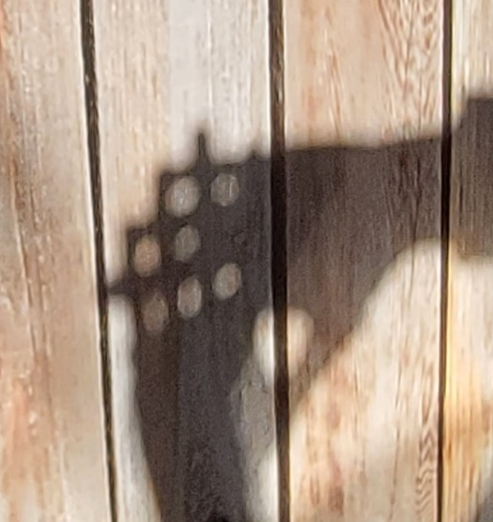
Pinhole Projection of the Sun
Play with sunlight shining through the gaps between your fingers to make round shapes of light on a projection surface.
Outreach for the NASA PUNCH mission
Round images of the Sun
projection surface
Gaps between crossed fingers are like the holes in the pinhole projector,
Our crossed fingers form the holes of the pinhole projector (left).
The wooden fence is the projection surface.
The round shapes of light are images of our nearest star, the Sun!
Notes:
https://www.exploratorium.edu/eclipse/video/solar-eclipse-hands-safe-viewing-techniques PAUL DOHERTY’s 36 sec video using Triangular Card and Hands

Slide 7
Pinhole Projection of the Sun
How many images of the Sun can you create with your hands?
Be playful! Explore different ways. What works best for you?
Outreach for the NASA PUNCH mission
Try different positions of your hands and fingers.
Different times of day.
Different types of projection surfaces.
Different distances between your hands and the projection surface.
Have fun playing with this to see what you can discover.

Slide 8
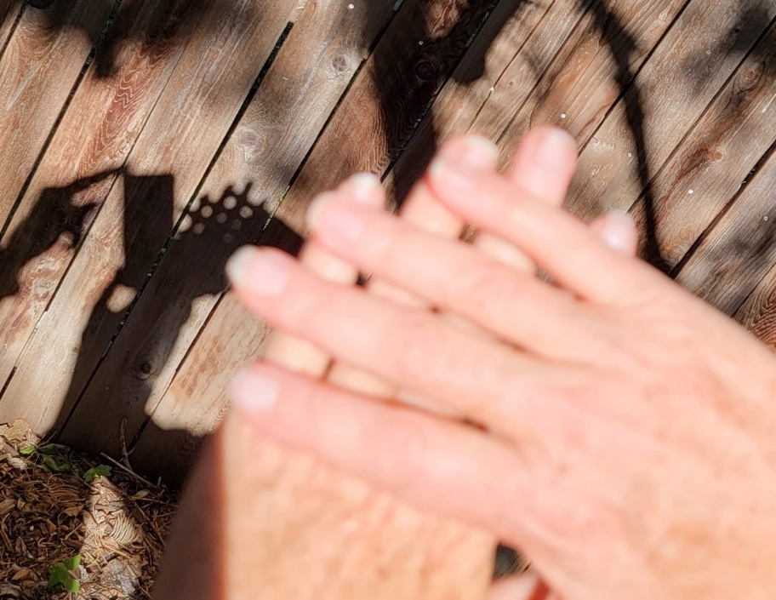
Pinhole Projection of the Sun
Use a fence, a wall, sidewalk, or paper for the projection surface depending on the time of day and how high the Sun is in the sky.
Outreach for the NASA PUNCH mission
Projecting on a vertical fence with morning sunlight
Projecting on a sidewalk with midday sunlight
Can you find the shadow of the cell phone camera? Can you tell where the photographer is located?
8th graders at the Haak’u Community Academy at the Pueblo of Acoma invented a palms-up approach.
Can you find other ways to make pinhole
images of the Sun using your hands?
Try one palm up and the other facing down?

Slide 9
Pinhole Projection of the Sun
Look closely at the back of the hands.
What shapes are the gaps between the crossed fingers? Are they round?
Gaps between crossed fingers are like the holes in the pinhole projector,
What do you think would happen to the images of the round Sun if the hands were moved closer and closer to the fence? Would the shapes of light between the fingers stay round?

Slide 10
Pinhole Projection of the Sun
No, the gaps between the fingers are not round.
They rectangular or square-shaped (left image).
If the hands were close enough to the fence, we’d see the shapes of the gaps on the fence instead of images of the round Sun.
Outreach for the NASA PUNCH mission
Then why do round shapes of light show up on the fence?
KEY QUESTION: How can small, non-round holes through leaves, window blinds, hats, and fingers act like lenses to create images of the round Sun?

Slide 11
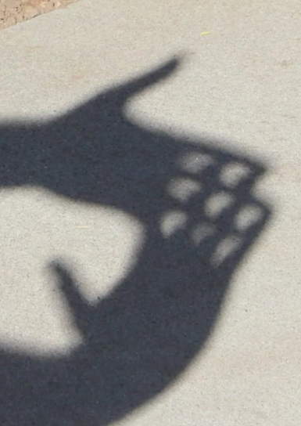
Pinhole Projection of the Sun
Observing the 2017 solar eclipse using a simple pinhole projector with a single square hole and also with crossed fingers
Outreach for the NASA PUNCH mission
Pinhole images of the Sun being eclipsed by the Moon

Slide 12
ADDITIONAL INFORMATION
Outreach for the NASA PUNCH mission
Link for Feedback
Valuable References
Credits & Acknowledgements
Links to PUNCH & PUNCH Outreach Products
CONTACT:
Dr. Cherilynn Morrow, Outreach Director for the NASA PUNCH mission [cherilynn.morrow@gmail.com]

Slide 13
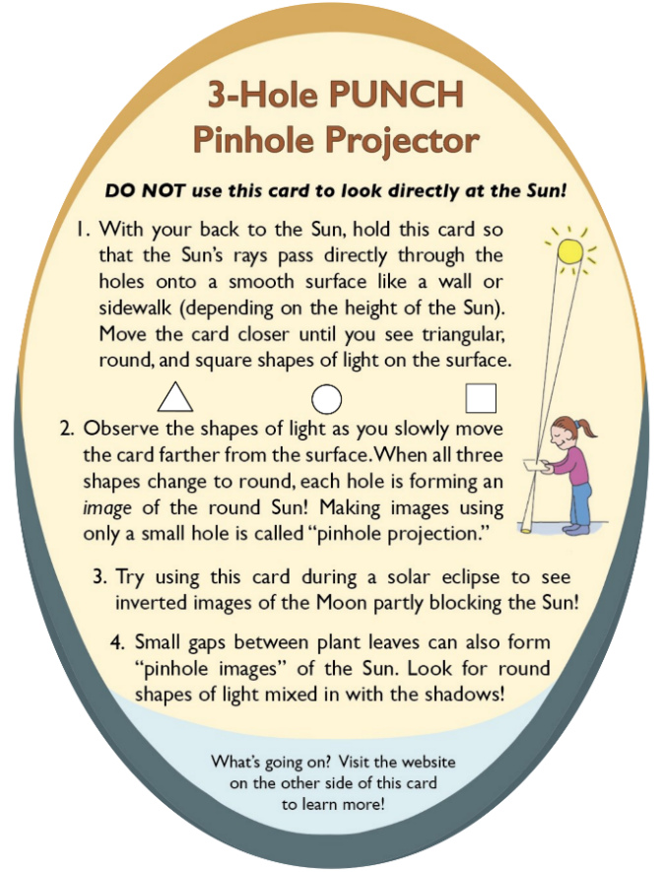
PLEASE GIVE US YOUR FEEDBACK
We take all feedback very seriously and are using it to keep improving our projector and this presentation.
Outreach for the NASA PUNCH mission
Please scan the QR code or go to this URL to give us feedback
​https://tinyurl.com/PinholeFeedback
Insights gained?
Remaining questions?
Ideas for improvements?
MARK 3 Version
Final Release for use up to and including the Annular Eclipse on 14 Oct 2023
FRONT
BACK

Slide 14
Valuable References
Lenses and Pinholes: What Does “In Focus” Mean?
A brief and clear explanation about what it means to be “in focus”: https://www.physicsforums.com/insights/lenses-pinholes-focus-mean/
2. How a Pinhole Camera Works (Part 1)
Excellent diagrams:
https://www.scratchapixel.com/lessons/3d-basic-rendering/3d-viewing-pinhole-camera
3. Real image: Collection of focus points made by converging light rays
We love the simple but insightful stick-figure:
https://www.wikiwand.com/en/Real_image
4. Your Eyes See Upside Down and Reversed
Lucid explanation by an eye doctor (MD) relating human eye to a pinhole camera: https://bceye.com/retinal-image-inverted-reversed/
5. Camera Obscura
The history of this wondrous effect, including reference to a possible paleo-camera:
https://en.wikipedia.org/wiki/Camera_obscura http://paleo-camera.com/archeo-optics/
6. Making, Measuring and Testing the “Optimal” Pinhole
A thorough and playful journey through the technical details of pinhole photography: https://www.35mmc.com/26/10/2020/making-measuring-and-testing-the-optimal-pinhole-pinhole-adventures-part-3-by-sroyon/

Slide 15
Credits & Acknowledgements
Primary Authors of the Explanatory Presentations:
Cherilynn Morrow, Robert Bigelow, and Mike Zawaski
cherilynn.morrow@gmail.com , arca965@gmail.com, and mjzawaski@gmail.com
Research & Development Team for the 3-Hole PUNCH Pinhole Projector
Cherilynn Morrow (editor-in-chief, concept development, field testing, photos)
Robert Bigelow (concept development, technical specifications, text reviewer, photos)
Briana Ingermann (graphic design, text developer, field testing, procurement of printing, photos)
Mike Zawaski (reviewer/consultant on explanatory presentation, graphic support, photos)
Sanlyn Buxner (head of field testing and evaluation, photos)
Jason Trump, Nina Byers, Geoff Skelton (text reviewer, field testing, reviewer of explanatory presentations)
Marisa Bevington & Marialis Rosario Franco (text reviewers, Spanish language translation)
GB Cornucopia, Bobbye Middendorf, Jeremy Osowski, Stacy Wolff (text reviewers, field testers, photo collaborators)
Craig DeForest (PUNCH PI, product review and approval, field tester)
Sarah Gibson (PUNCH Project Scientist, product review and approval)
Nicki Viall (PUNCH Mission Scientist, field tester, product review and approval)
Ronnie Killough (PUNCH Program Manager, field tester)
Gilly Gilbert (PUNCH Associate Investigator, field tester)
Countless others (who participated in field testing events and gave us their feedback)
Thank you also to our web developer Don Kolinski for posting and updating our work on the PUNCH website.

Slide 16
Please proceed to Section 4:
Explaining and Understanding How Pinhole Imaging Happens
NASA PUNCH website: https://punch.space.swri.edu /
Scan here to access all PUNCH Outreach products or visit:
https://punch.space.swri.edu/punch_outreach_products.php
For questions or to request our 1-page monthly newsletter: Contact PUNCHOutreach@gmail.com
Photo: Alan Friedman

