Slide 1
Pinhole Slides for Display or Presentation
Supporting Visuals for the 3-Hole-PUNCH Pinhole Projector
1
Notes:
1 min
The charged particle flow from the Sun – the solar wind - defines the heliosphere - the region of space influenced by the Sun. The heliosphere extends out beyond the orbit of Pluto until it peters out at a boundary with interstellar space.
PUNCH focuses on the Inner Heliosphere between Sun and Earth.
The four PUNCH cameras in Earth orbit will allow 3D imaging of the solar wind - from the outer solar corona all the way to Earth orbit
This will allow the corona and solar wind of the inner heliosphere to be studied as a unified system FOR THE FIRST TIME!
As a result, PUNCH will be providing a pioneering new capacity for solar storm tracking & space weather monitoring…..

Slide 2
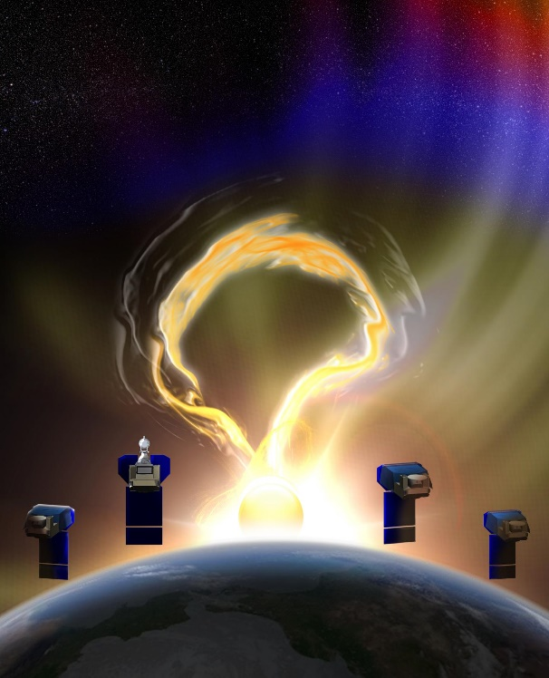
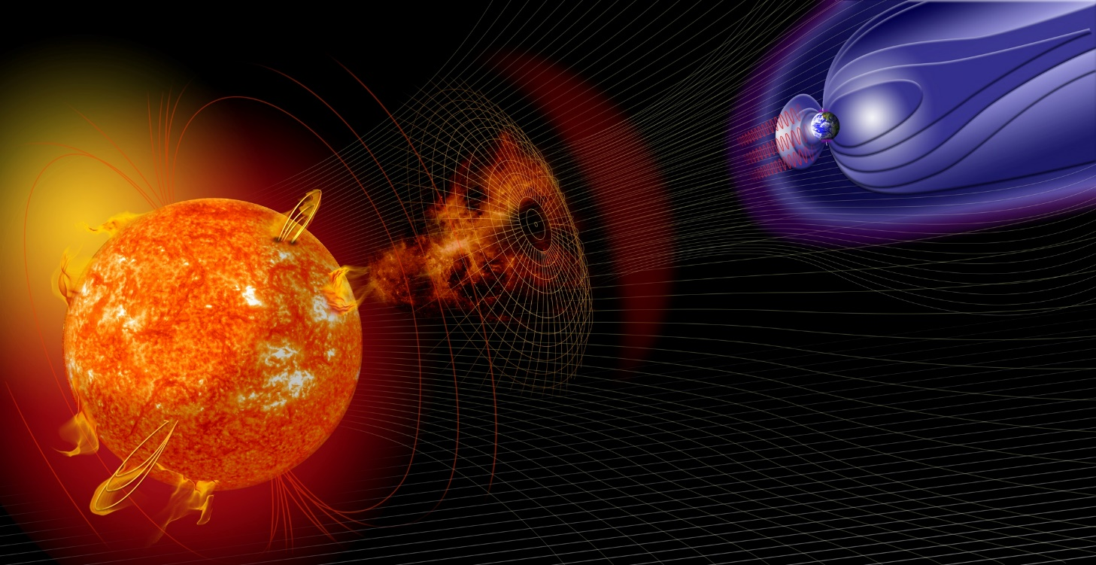
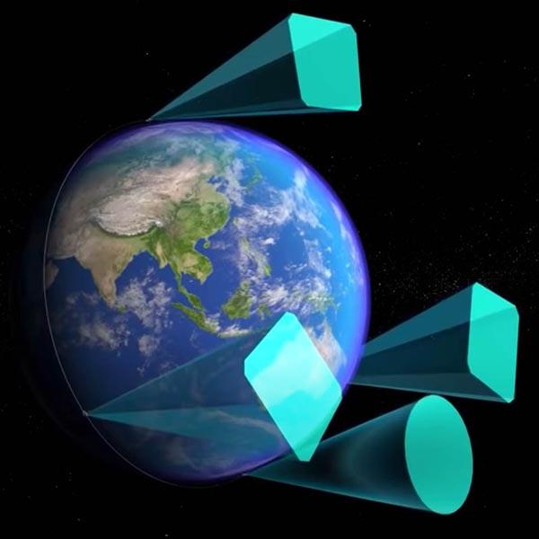
The NASA PUNCH Mission
PUNCH = Polarimeter to UNify the Corona and Heliosphere
PUNCH studies the Sun and the space between Sun and Earth as one UNIFIED system.
PUNCH studies the Sun’s outer atmosphere (called the solar CORONA) and how it expands to become the “solar wind” that fills the space between Sun and Earth (called the inner HELIOSPHERE).
Artist’s conception: Not to scale
Artist’s conception: Not to scale
PUNCH uses POLARIZED LIGHT to study the science of “Space Weather.” Its four cameras
(each one on an Earth-orbiting satellite) combine to track solar storms better than ever before!
Activity CONNECTION: See Pinhole Magic
* The PUNCH mission outreach theme is Ancient and Modern Sun-watching
* Your personal Sun-watching is an important part of the theme
* Learning to observe pinhole images of the Sun in our everyday environments (both indoors and outdoors) is a fun way to stay connected to the star on which all life depends!
Activity: See Pinhole Magic - Indoors and Outdoors Contact: punchoutreach@gmail.com
2
Notes:
1 min
The charged particle flow from the Sun – the solar wind - defines the heliosphere - the region of space influenced by the Sun. The heliosphere extends out beyond the orbit of Pluto until it peters out at a boundary with interstellar space.
PUNCH focuses on the Inner Heliosphere between Sun and Earth.
The four PUNCH cameras in Earth orbit will allow 3D imaging of the solar wind - from the outer solar corona all the way to Earth orbit
This will allow the corona and solar wind of the inner heliosphere to be studied as a unified system FOR THE FIRST TIME!
As a result, PUNCH will be providing a pioneering new capacity for solar storm tracking & space weather monitoring…..

Slide 3
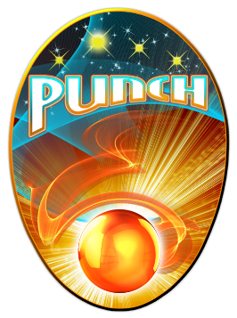
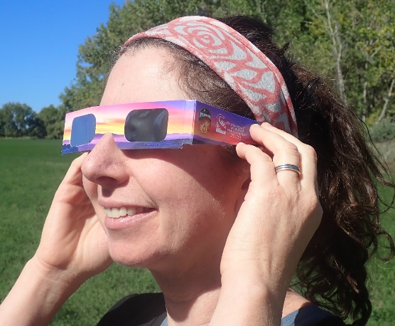
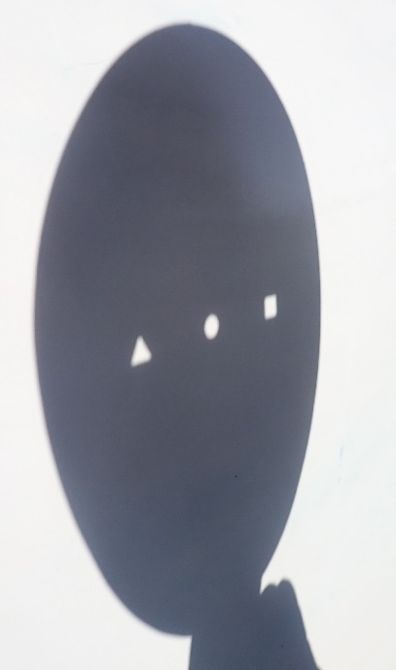
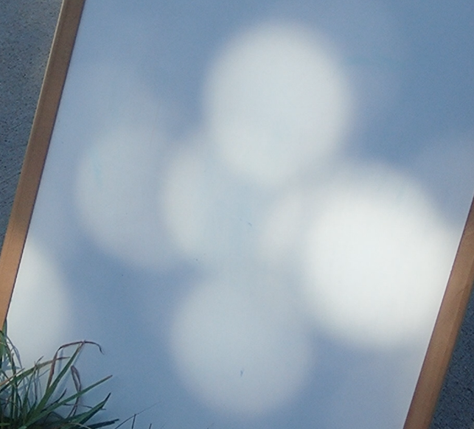
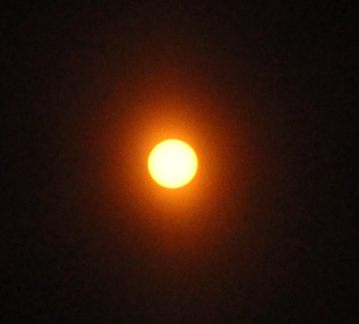
3-Hole-PUNCH Pinhole Projector:
Four “Aha” learning moments for outdoor use with the Sun
Aha 4: When learners see pinhole images of the Sun that are formed by irregularly shaped gaps between leaves and recognize this as the same phenomenon caused by the holes of the Projector.
Start with the Projector close enough to the projection surface that the shapes of light are the shapes of the holes
Aha 1: When learners see all three shapes of light turn round as the projector is pulled away from the projection surface…
Aha 2: When learners see the three images of the round Sun become larger than the holes as the projector is pulled farther away…
Aha 3: When learners confirm that the shape of the light source is round by observing the Sun directly with solar protection glasses…
Activity: See Pinhole Magic - Indoors and Outdoors Contact: punchoutreach@gmail.com

Slide 4
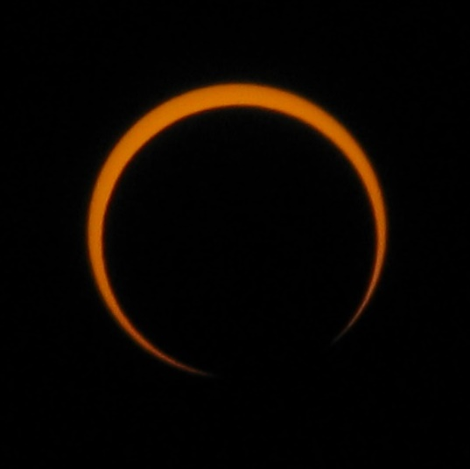
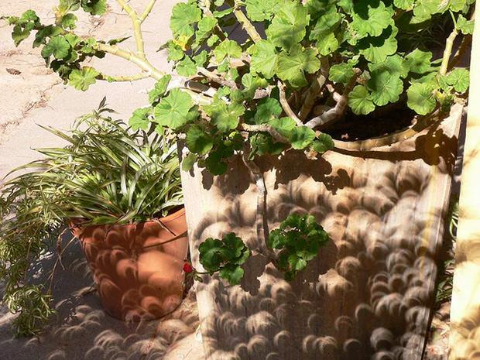
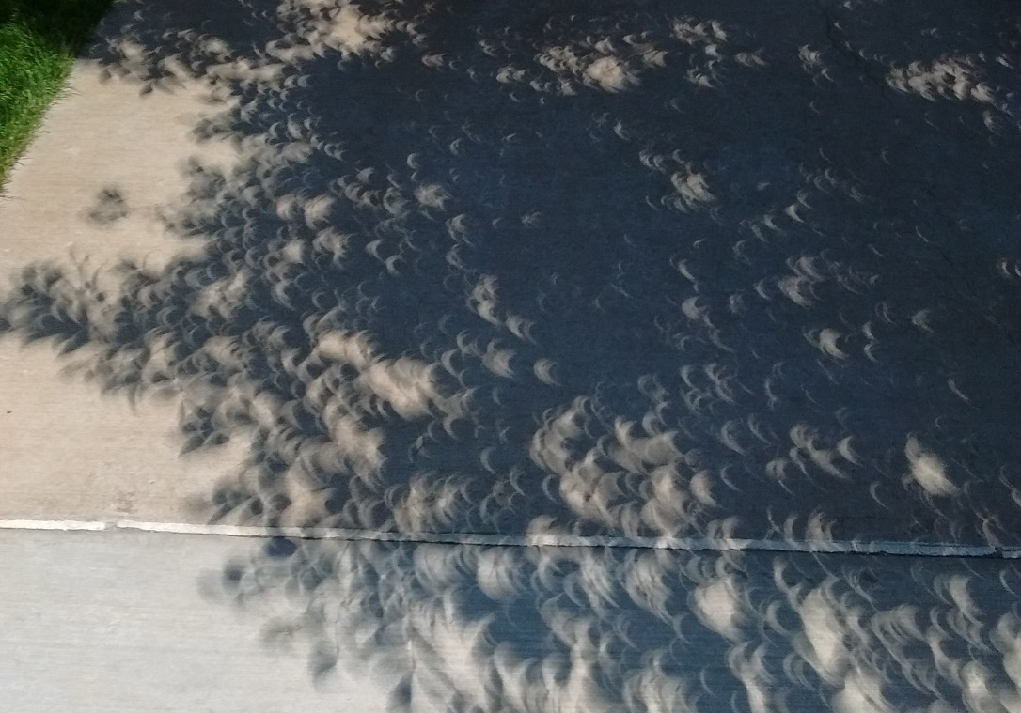
Pinhole Projection of the Sun
During solar eclipses it’s easy to tell that we are seeing real images of the Sun formed by small gaps between plant leaves.
Image by Cantavestrella.
Image by R. Bigelow
Activity: See Pinhole Magic - Indoors and Outdoors Contact: punchoutreach@gmail.com

Slide 5
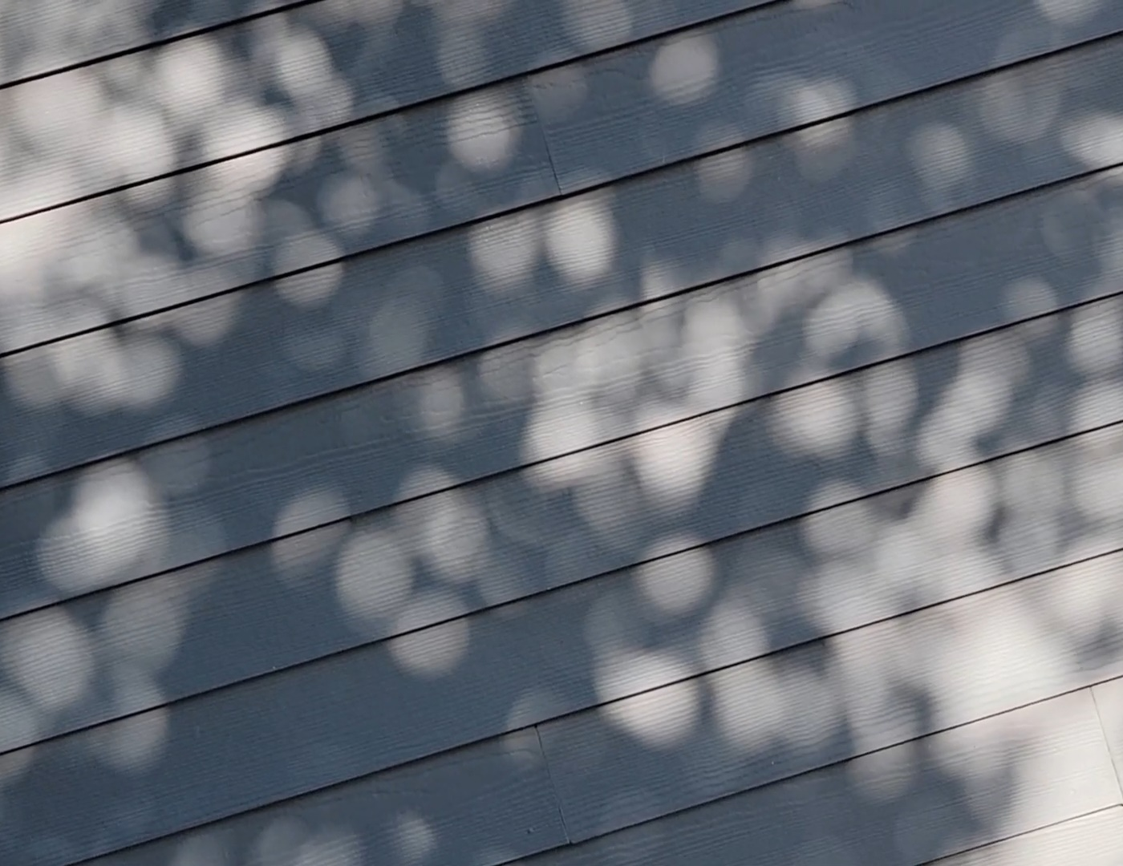
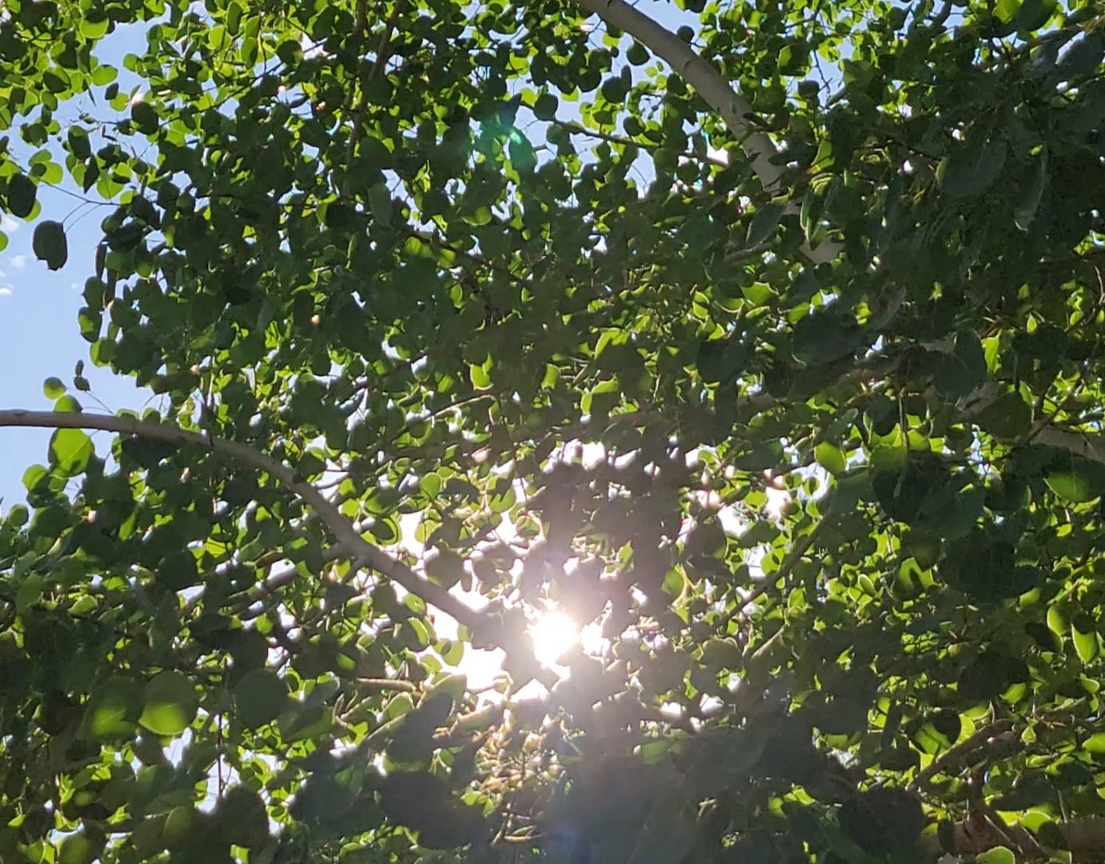
Pinhole Projection of the Sun
Pinhole images of the Sun are all around us without eclipses. Look for them wherever sunlight streams through small gaps between leaves or pine needles. Learn to see them!
Go on a pinhole image Scavenger Hunt in your neighborhood!
21 August 2017
Roberts, Idaho
10:52 am
Image by C. Morrow
Image by C. Morrow
When the Sun is lower in the sky (early morning and late afternoon) it is easier to see pinhole images of the Sun on a vertical surface. When the Sun is higher in the sky (during midday) you can find them among shadows under your feet.
Activity: See Pinhole Magic - Indoors and Outdoors Contact: punchoutreach@gmail.com

Slide 6
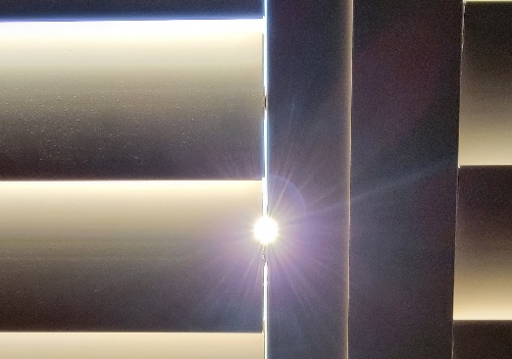
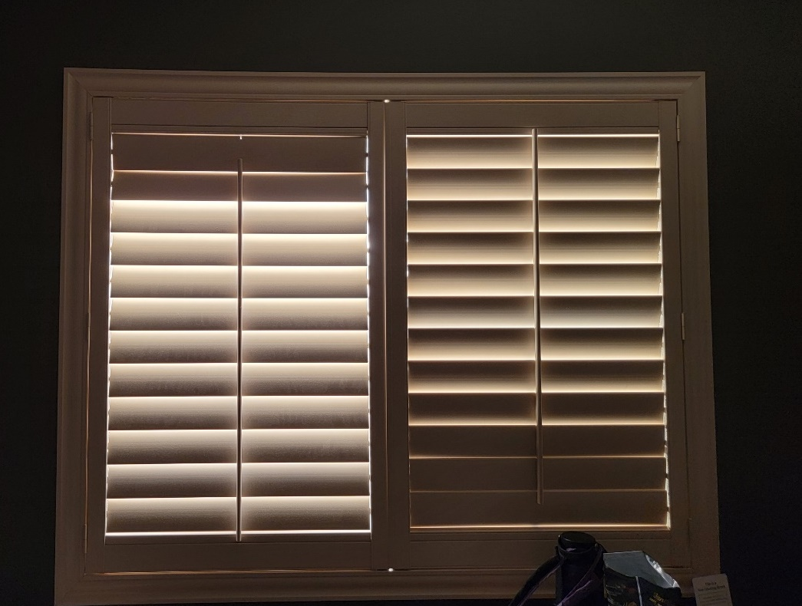
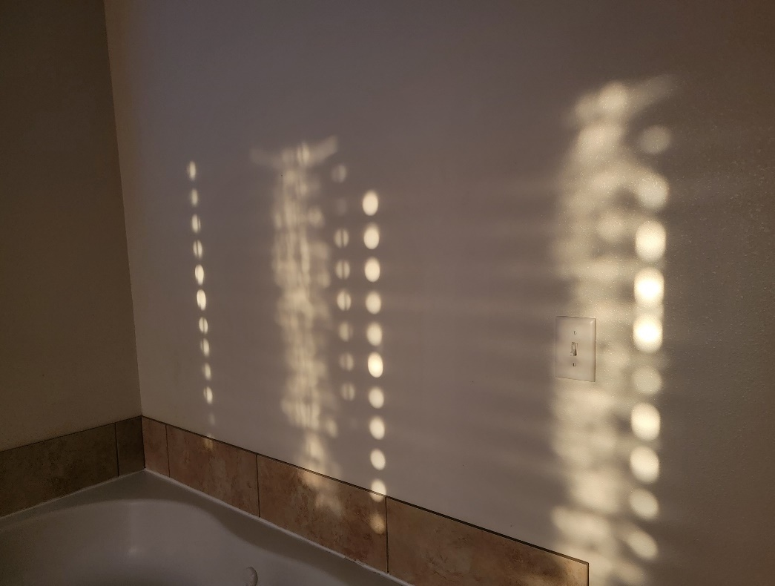
Pinhole Projection of the Sun
Look for pinhole images of the Sun indoors when sunlight passes through narrow gaps at the edges of window blinds.
These small gaps at the edges of the blinds are long, thin rectangles
But see how perfectly round are the images of the Sun they project on the wall!
Image by C. Morrow
Image by C. Morrow
Activity: See Pinhole Magic - Indoors and Outdoors Contact: punchoutreach@gmail.com

Slide 7
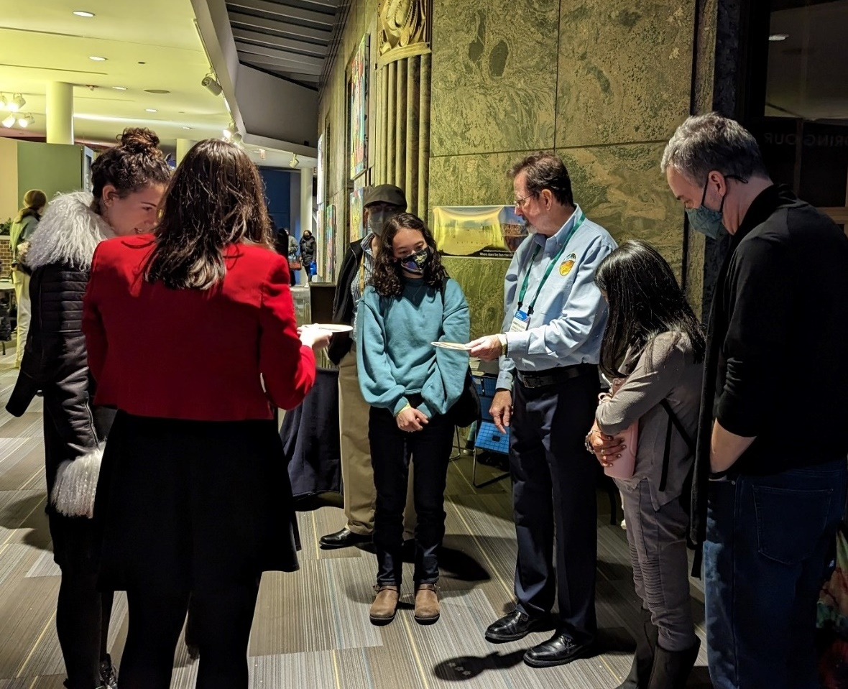
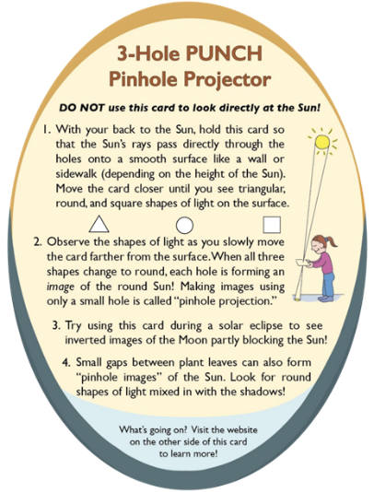
Using an Indoor Light Fixture as a Light Source
Being observant and playful leads to cool discoveries!
In Dec 2022, PUNCH team members and collaborators contributing to a public engagement program at the Adler Planetarium in Chicago discovered that our projector could project images of the ceiling lights! As you can see below, at the Adler, the spotlights in the ceiling are star-shaped!
The images are star-shaped because the light source is star-shaped.
Activity: See Pinhole Magic - Indoors and Outdoors Contact: punchoutreach@gmail.com

Slide 8
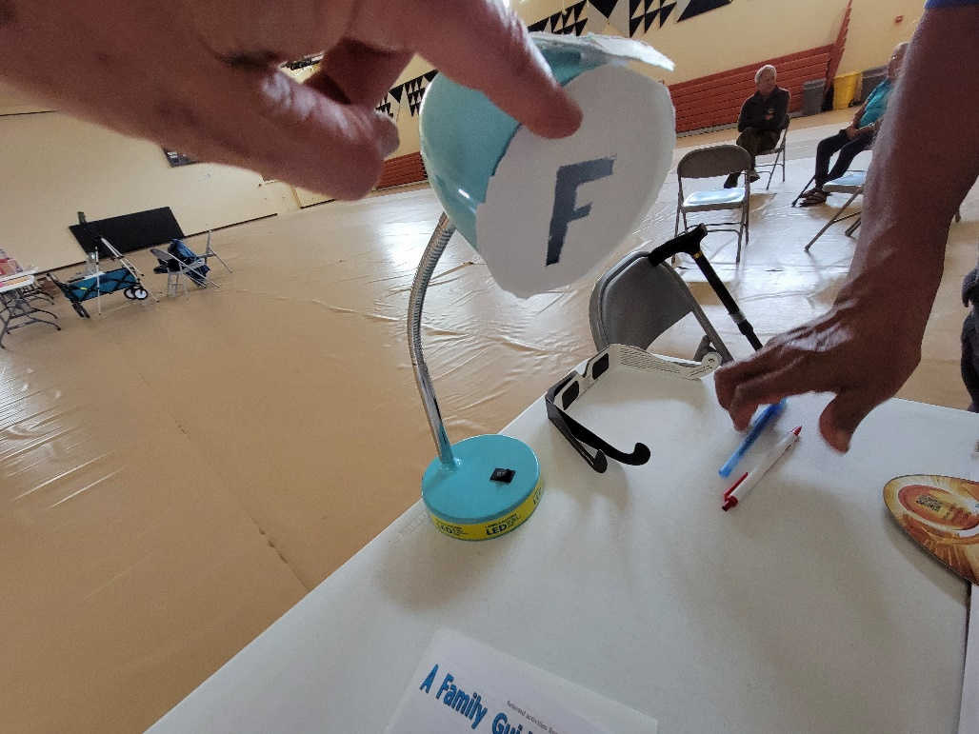
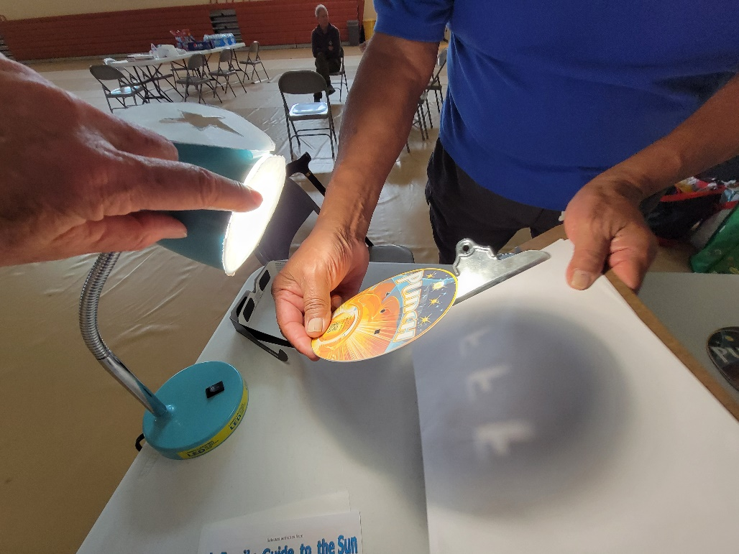
Using a Masked LED Desk Lamp as a Light Source
The cut-out mask makes the light source F-shaped.
The Projector forms inverted images of the light source.
Lamp OFF
Lamp ON
projection surface
The mask changes the shape of the light source.
The Projector holes are each imaging the F-shape of the light source. An “F” makes it easy to see how pinhole images are flipped both upside down and left-to-right.
pinhole images
NOTE: Try other shapes like a star or a crescent!
NOTE: If the Projector were held closer to the surface, we would still see the triangular, round, and square-shaped holes.
Activity: See Pinhole Magic - Indoors and Outdoors Contact: punchoutreach@gmail.com
8

Slide 9
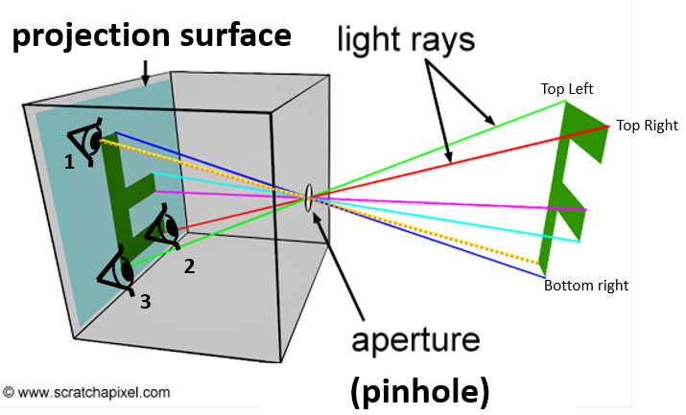
How Does the Inversion Work?
Imagine your own eye looking out from the projection surface toward the pinhole. What part of the F would you be able to see through the pinhole from positions 1, 2, 3?
For example, position 1 is on the upper part of the projection surface, but only receives light from the bottom of the F-shape.
Diagram adapted from scratchapixel.com
Activity: See Pinhole Magic - Indoors and Outdoors Contact: punchoutreach@gmail.com

Slide 10
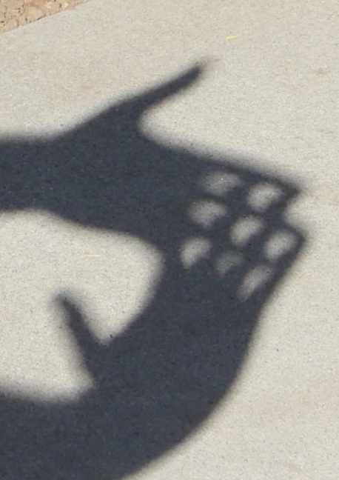
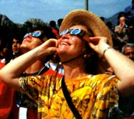
How does a pinhole image compare to the view through solar protection glasses?
21 Aug. 2017 from Roberts, ID at 10:52 am
2. Here’s what you would see through solar protection glasses at the same time.
1. Pinhole images of the round Sun being partially eclipsed by the Moon: Card and Hand methods.
CM observing a solar eclipse
Activity: See Pinhole Magic - Indoors and Outdoors Contact: punchoutreach@gmail.com

Slide 11
How Does the Inversion Work?
The key to reconciling the pinhole image with the direct observation is to identify the line of symmetry of the partial eclipse
TOP
Appearance through solar protection glasses (re-created using Starry Night)
21 Aug. 2017 from Roberts, ID at 10:52 am
BOTTOM
BOTTOM
BOTTOM
Flipped top-to-bottom
(along the green line of symmetry)
TOP
TOP
Pinhole image of the Sun partially eclipsed by the Moon
BOTTOM
Then flipped left-to-right*
(looks like the pinhole image)
* Same if we’d flipped left-to-right first before flipping top-to-bottom
TOP
Activity: See Pinhole Magic - Indoors and Outdoors Contact: punchoutreach@gmail.com

