Slide 1
Visuals to Support the PUNCH-CATE 2024 Outreach Collaboration
Slides:
Title and Table of Contents
CATE 2024: The Corona is Polarized (Rainbow Polarization Image from Patel et al.)
One-slide summary of the NASA PUNCH mission
How are PUNCH and CATE 2024 Related?
One-Slide Facilitator Guide: Observing Polarized Light in the Solar Corona
Seaton GIF animation of coronal changes when rotating polarized glasses by 90 degrees
Models for Solar Protection [“Eclipse”] Glasses vs. PUNCH Polarized Glasses
The PUNCH Field of View Compared to What We See During a Total Solar Eclipse
Polarized Light in Everyday Environments
Facilitating Powerful Learning Experiences Using the 3-Hole-PUNCH Pinhole Projector
‹#›

Slide 2
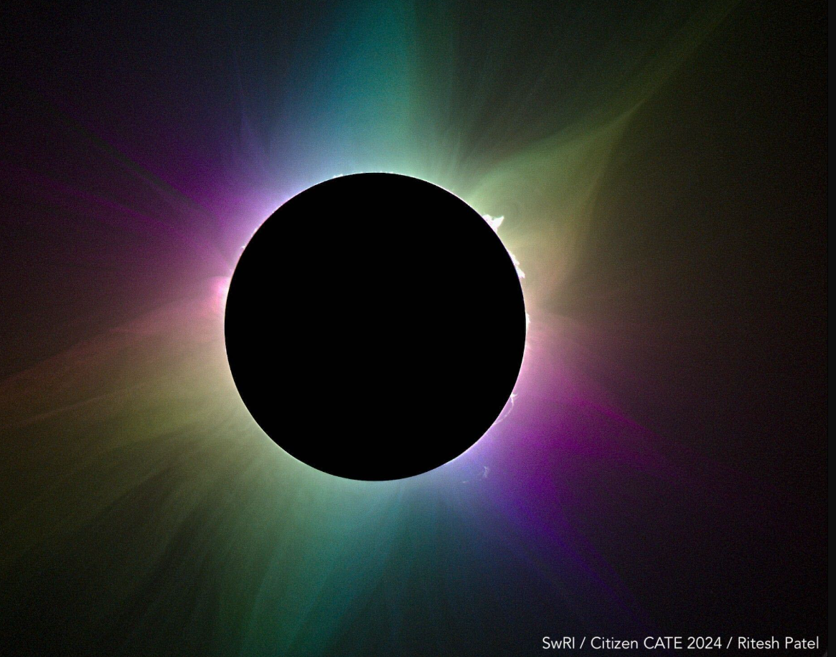
The Light of the Solar Corona is Polarized
The colors represent differences in polarization
‹#›
‹#›
Notes:
Recently, leveraging the analogy between polarization and colors, a vivid map of the solar corona representing polarization properties was presented, based on observations during the total solar eclipse in 2023.

Slide 3
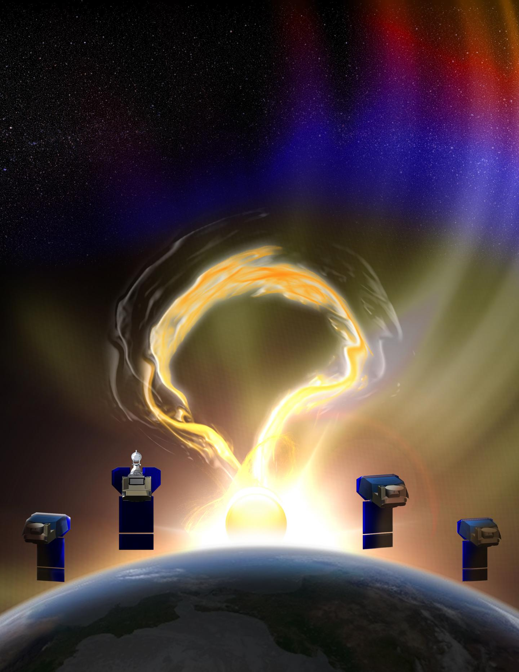
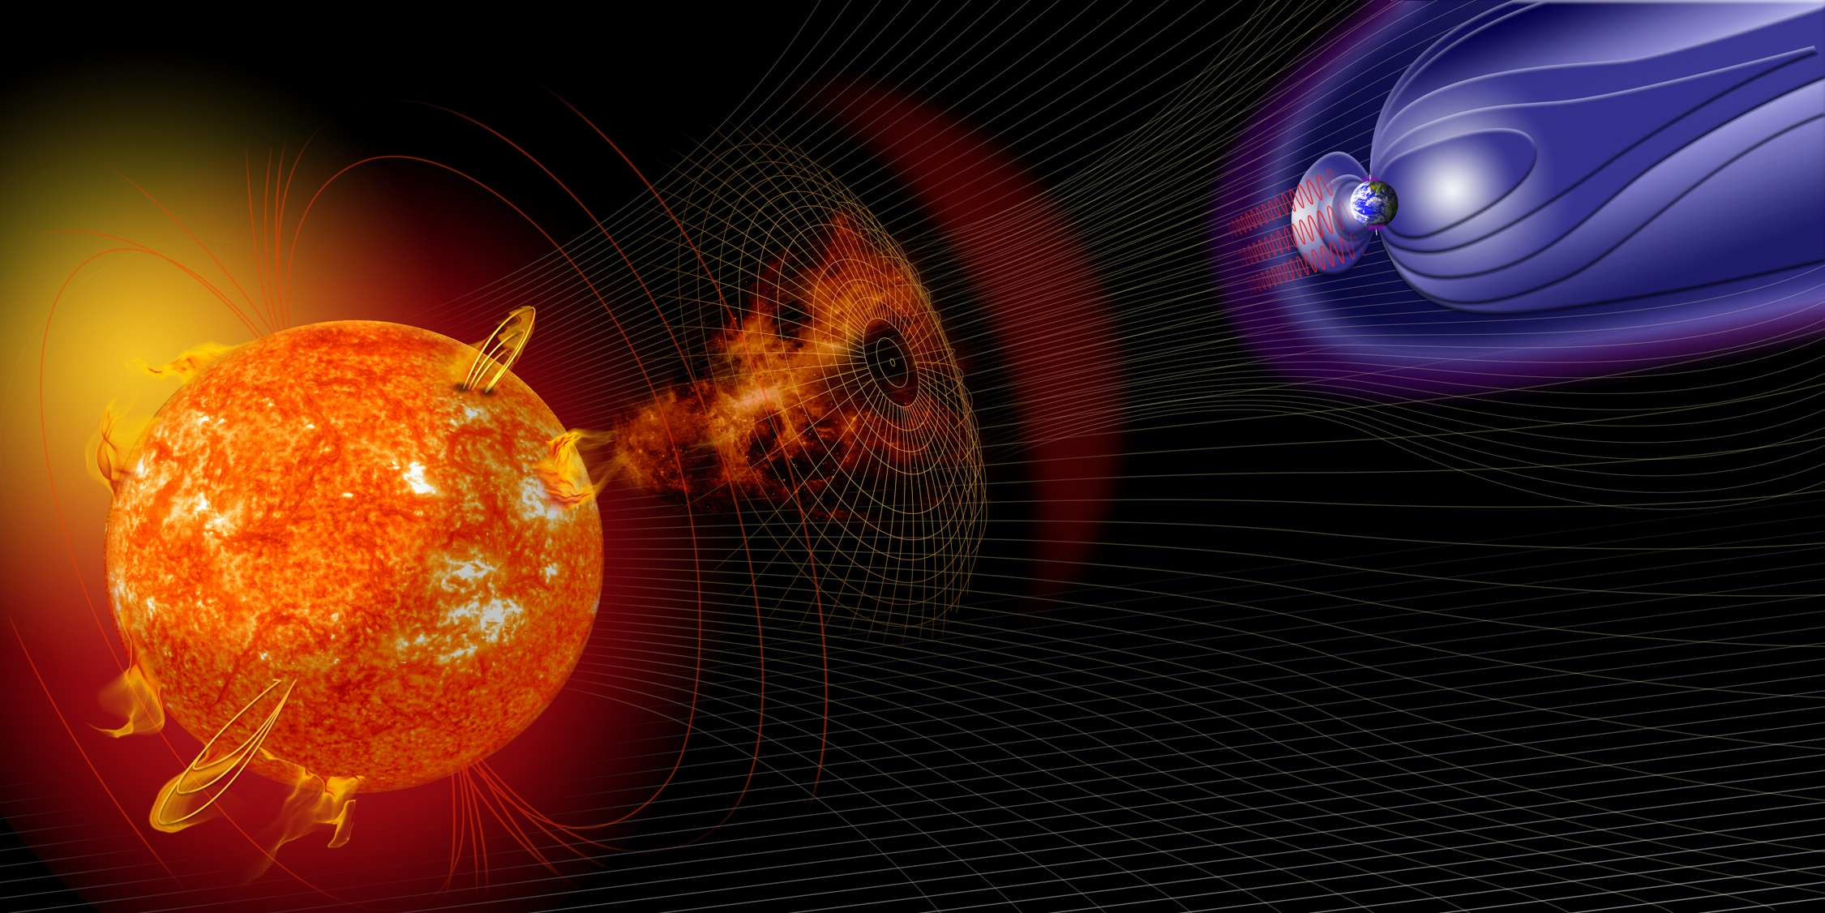
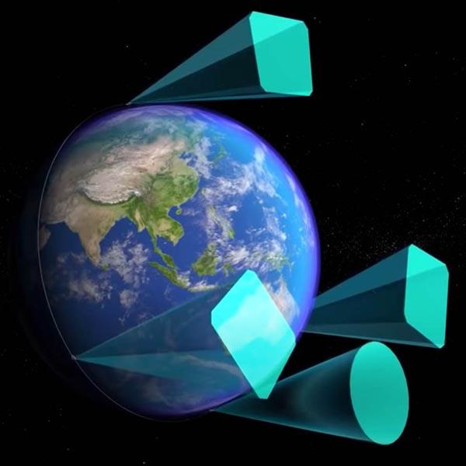
The NASA PUNCH Mission
PUNCH = Polarimeter to UNify the Corona and Heliosphere
PUNCH studies the Sun and the space between Sun and Earth as one UNIFIED system.
PUNCH studies the Sun’s outer atmosphere (called the solar CORONA) and how it expands to become the “solar wind” that fills the space between Sun and Earth (called the inner HELIOSPHERE).
Artist’s conception: Not to scale
Artist’s conception: Not to scale
PUNCH uses POLARIZED LIGHT to study the science of “Space Weather.” Its four cameras
(each one on an Earth-orbiting satellite) combine to track solar storms better than ever before!
Activity CONNECTION: What’s the P in PUNCH?
* PUNCH is designed to study bursts of particles streaming away from the Sun like solar storms and other space weather features.
* When particles (electrons) scatter sunlight the waves of light become aligned in a particular way. We call this polarized light.
* By measuring how much the light is polarized using a POLARIMETER, PUNCH scientists can make a 3D map of a particle burst
* The polarimeter in each PUNCH spacecraft has polarizing filters (similar to polarized sunglasses) in front of ordinary digital cameras.
* The amount of light that can be seen through these filters reveals how much the light from space weather features is polarized.
* You can see how this works by using polarized sunglasses to detect whether a source of light (e.g. computer screen) is polarized.
‹#›
Notes:
Hi Cherilynn,
This is great!
-Here is what I often say about polarized light: All light, including light from the Sun, is a type of wave. Sometimes the waves align in a particular way, and then we say that the light is polarized.
(This next bit is advanced. But I bet Seniors and Ambassadors could get it) The amount of polarized light that PUNCH measures depends on how far away that structure is from PUNCH. The ability to distinguish polarized light from unpolarized light makes a PUNCH 3D imager.
-For the Describing and Interpreting hand out, since the cookie is the Lemonade cookie (I assume the Girl Scout one?) that the girl scouts will know shouldn't lemon be on this list of cross section interpretation with orange or grapefruit?
-For the Patch Passport, the word corona is in there without a definition. You could either add the usual 'atmosphere of the Sun' or just make sure that the facilitators know to mention the definition.
Thanks,
Nicki
The charged particle flow from the Sun – the solar wind - defines the heliosphere - the region of space influenced by the Sun. The heliosphere extends out beyond the orbit of Pluto until it peters out at a boundary with interstellar space.
PUNCH focuses on the Inner Heliosphere between Sun and Earth.
The four PUNCH cameras in Earth orbit will allow 3D imaging of the solar wind - from the outer solar corona all the way to Earth orbit
This will allow the corona and solar wind of the inner heliosphere to be studied as a unified system FOR THE FIRST TIME!
As a result, PUNCH will be providing a pioneering new capacity for solar storm tracking & space weather monitoring…..

Slide 4
How are PUNCH and CATE 2024 Related?
The NASA PUNCH mission uses four Earth-orbiting satellites to observe the outer solar corona and inner heliosphere between Sun and Earth.
CATE 2024 is an NSF and NASA-supported network of 35+ teams using ground-based telescopes distributed along the path of totality to observe the inner corona.
Both CATE 2024 and PUNCH examine the solar corona in polarized light, which allows us to measure its complex 3D structure.
Both CATE 2024 and PUNCH study the origins of the solar wind that streams out of the Sun to fill the Solar System and defines the heliosphere.
CATE 2024 takes advantage of a total solar eclipse to look much closer to the Sun than we can normally see, even with existing instruments in space.
PUNCH can routinely observe much farther from the Sun than the corona we see during an eclipse.
The data from both CATE 2024 and PUNCH can be used to detect changes in their fields of view (which could be) due to solar storms.
CATE 2024
eclipse.boulder.swri.edu
PUNCH
punch.space.swri.edu
‹#›

Slide 5
Observing Polarized Light in the Solar Corona
A one-slide guide for eclipse-knowledgeable facilitators only
CAUTION! Use of polarized glasses is safe ONLY during totality.
During totality ONLY (and at no other time) invite observation of the solar corona through the polarized lenses.
Use a digital timer or an eclipse-timer phone app to alert you just before the end of totality.**
Warn everyone in the group to stop observing before totality ends — before any light of the Sun’s disk re-appears.
To avoid confusion, do not loan polarized glasses until totality begins. Be sure to collect just before totality ends.
Rotate the lenses clockwise 90○ and back to look for any changes in brightness and structure in the Sun’s corona.
What’s safe to wear during the eclipse
Partial Eclipse Phases
Partial Eclipse Phases
Totality
** Solar Eclipse Timer, by Foxwood Astronomy is available for both iPhone and Android
‹#›

Slide 6
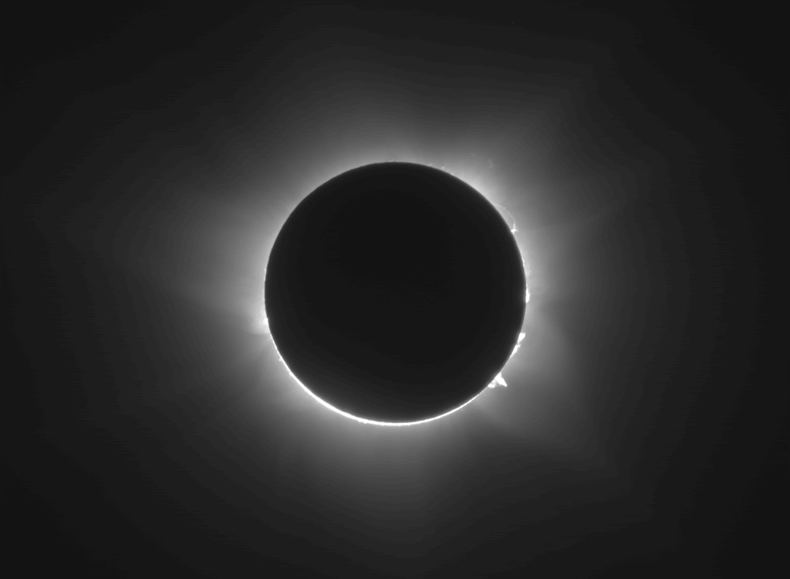
A GIF animation of how the corona may appear
to change when rotating polarized glasses by 90◦
GIF animation provided by Dan Seaton and the CATE 2024 team
eclipse.boulder.swri.edu
‹#›

Slide 7
For Your EYE Safety
Know Which Glasses to Wear When
Solar Protection (“Eclipse”) Glasses
Use these during all partial eclipse phases
PUNCH Polarized Glasses
Use these to observe the corona during TOTALITY ONLY
‹#›

Slide 8
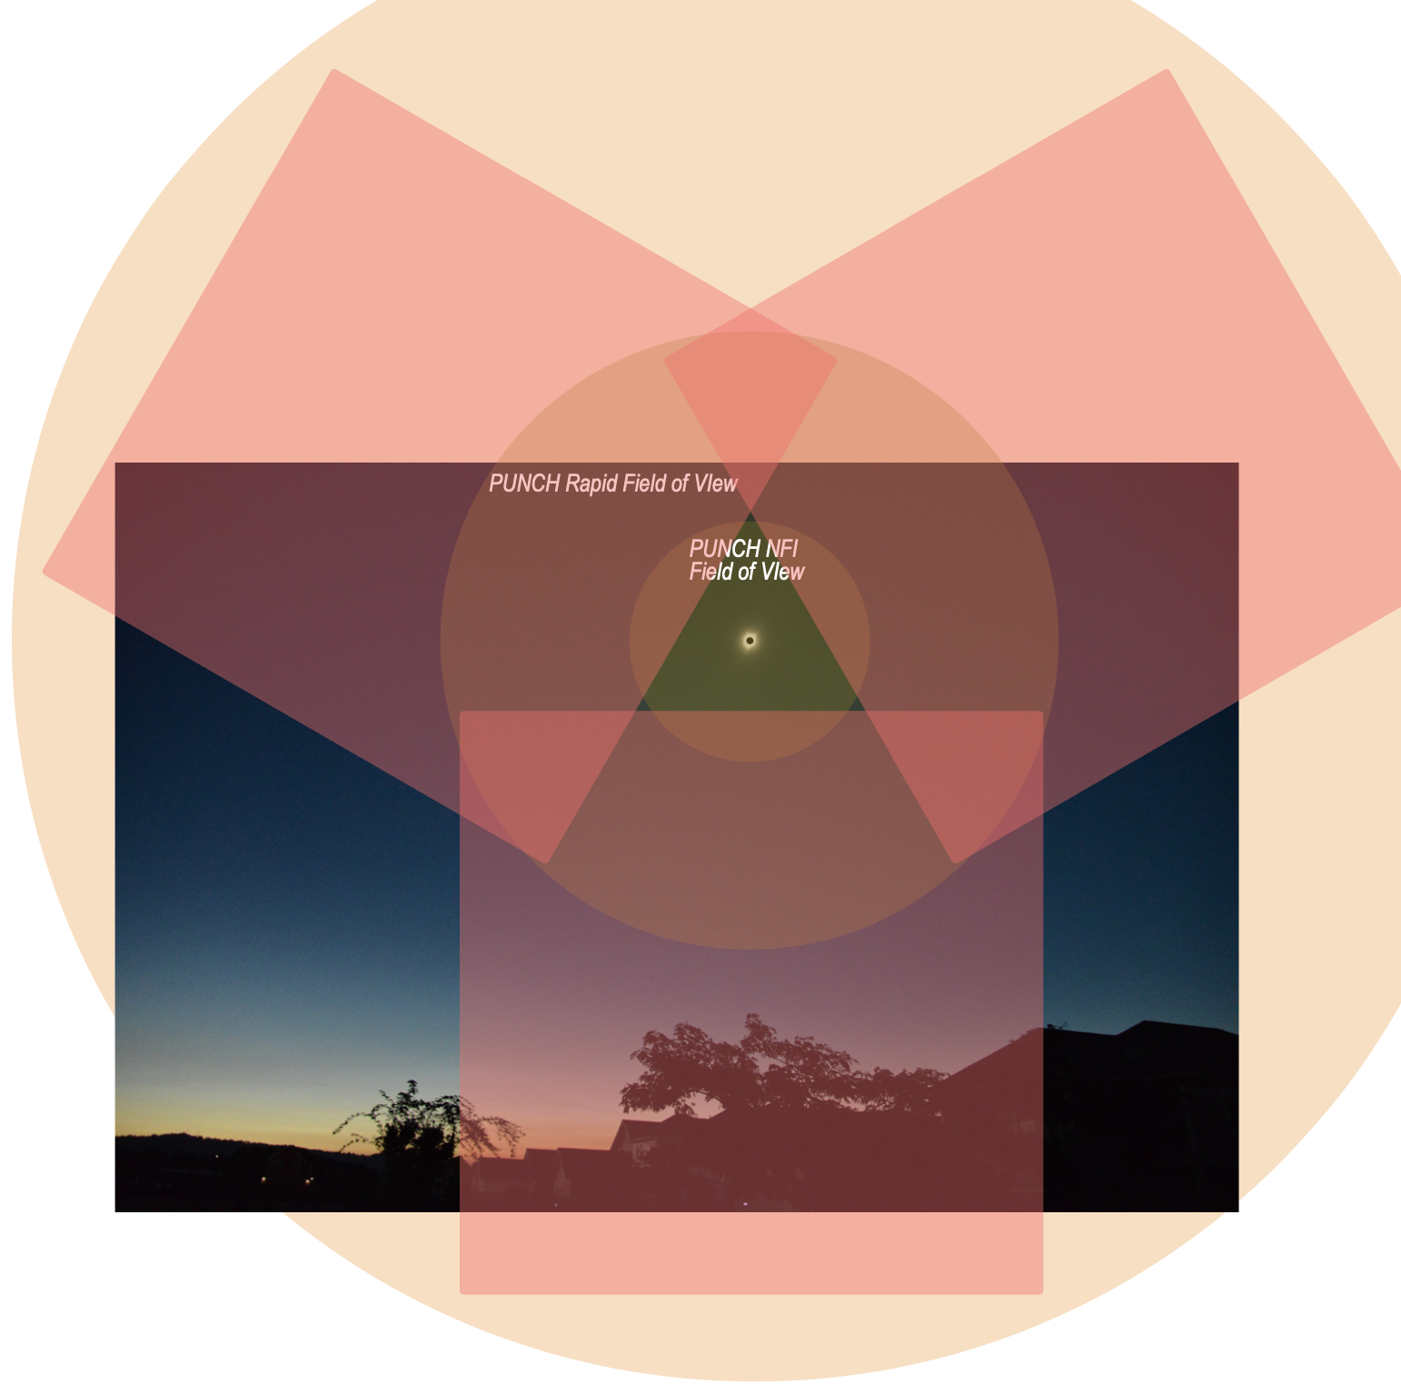
The PUNCH Field of View Compared to What We See During a Total Solar Eclipse
The 2017 total solar eclipse at totality
Overlay by PUNCH Principal Investigator Craig DeForest. Original image of 2017 eclipse at totality by PUNCH Mission Scientist Nicki Viall
‹#›

Slide 9
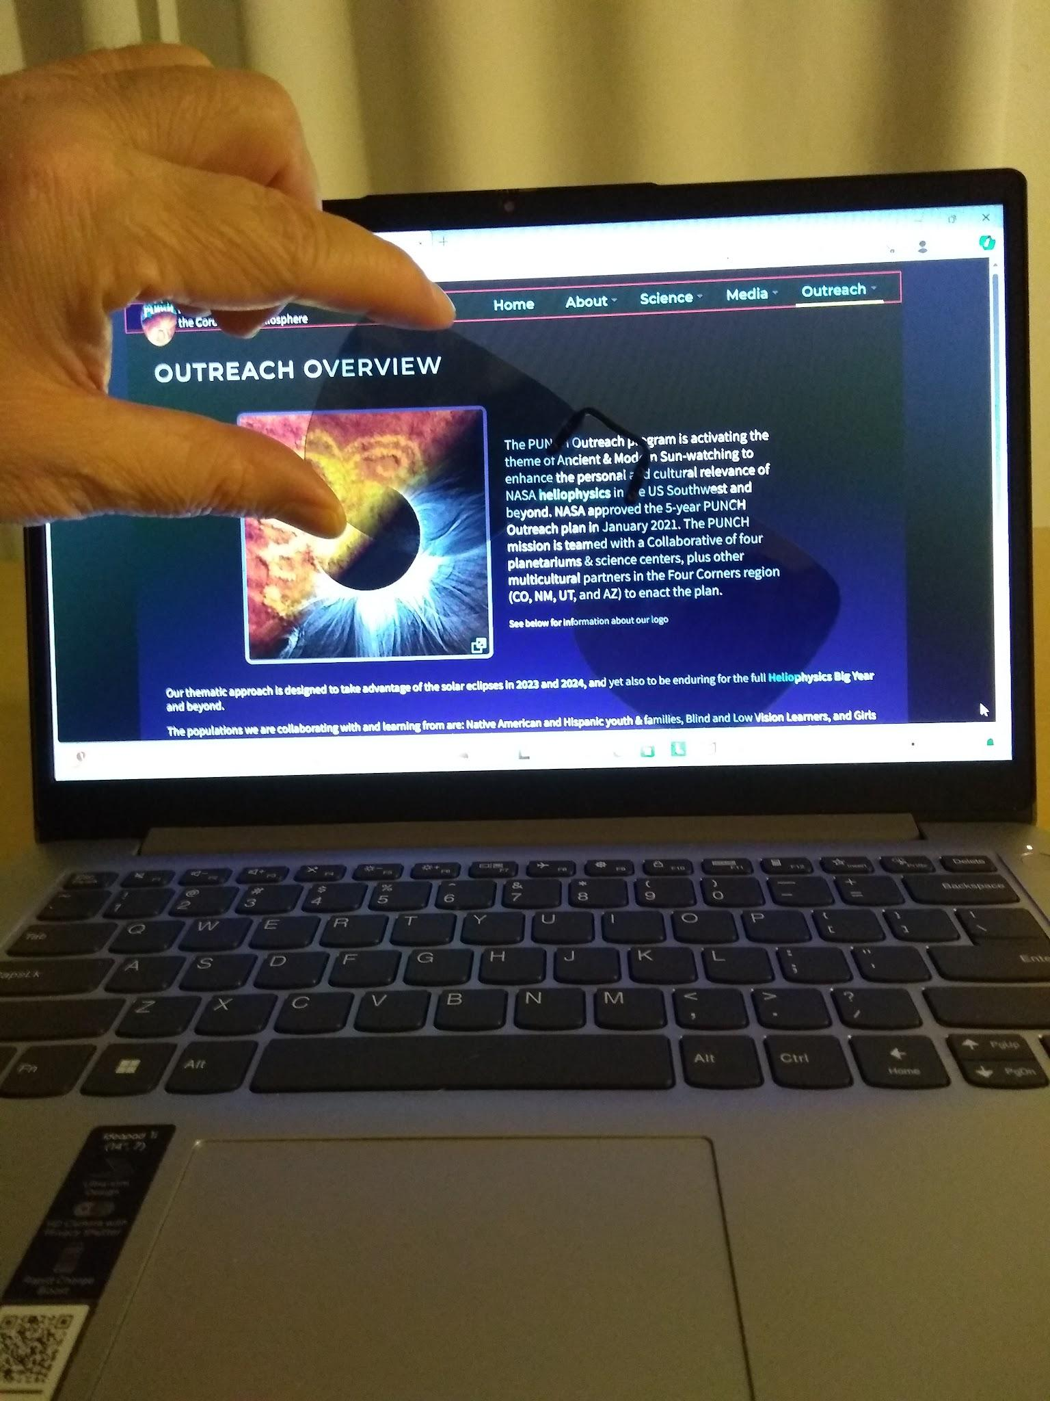
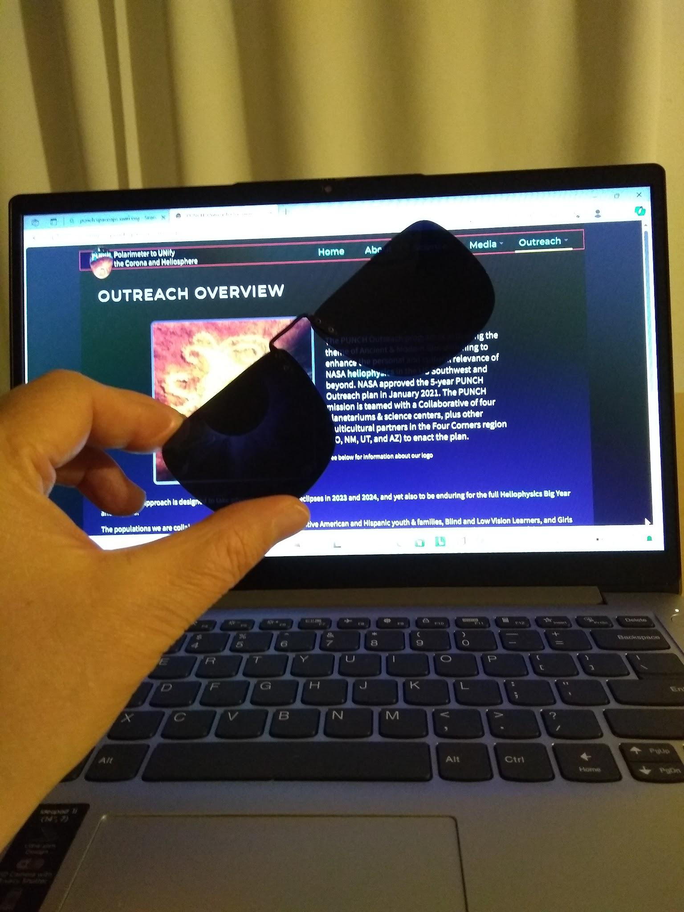
Polarized Light in Everyday Environments
Use polarized sunglasses to find polarized light!
THE SIMPLE TEST:
If the brightness changes dramatically as you rotate a polarized lens,
then the light source is strongly polarized (e.g., the light from a computer screen).
Indoor Sources of Polarized Light
Light reflected off of a shiny surface (e.g. shiny tabletop or floor, glass picture frame)
LCD screen (e.g. computer, TV, cell phone - see demo at right)
Outdoor Sources of Polarized Light
The solar corona during totality (ONLY visible during the totality phase of a solar eclipse)
[For safety this activity requires facilitation by an eclipse expert]
Sunlight scattered by air molecules (at different directions relative to the Sun)
[Requires facilitation by an adult who knows safe solar viewing practices]
Reflections off of water, snow, shiny surfaces
Rainbows (polarized along direction of the arc)
Compare these two carefully
‹#›

Slide 10
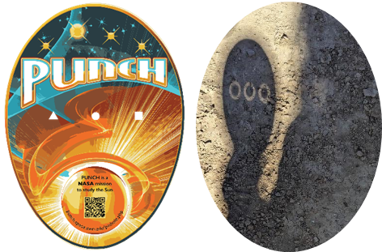
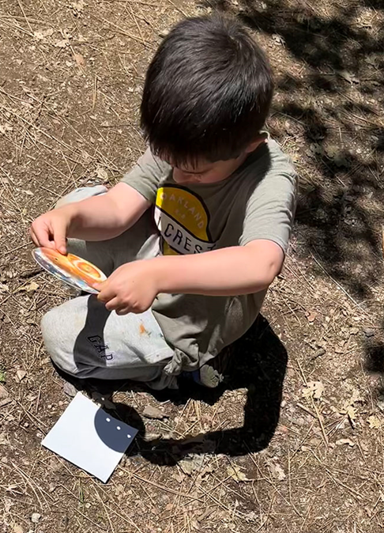
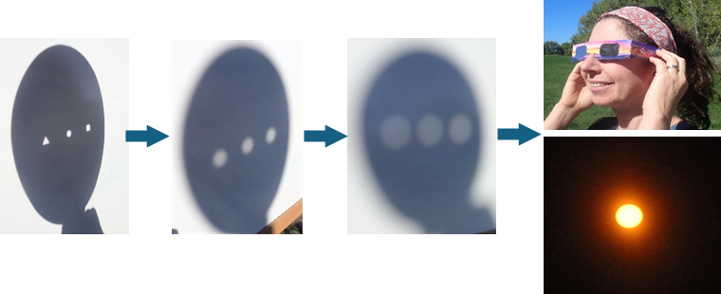
Facilitating Powerful Learning Experiences Using the 3-Hole-PUNCH Pinhole Projector
We strongly recommend viewing our short videos to prepare you to maximize delight, curiosity, and wonder for yourself and your learners!
tinyurl.com/PUNCHOutreachPinholeVideos
The 3 “AHA” Transitions
BAAS Journal article on PUNCH Outreach Products DOI: 10.3847/25c2cfeb.25cd07d9
‹#›

