Slide 1
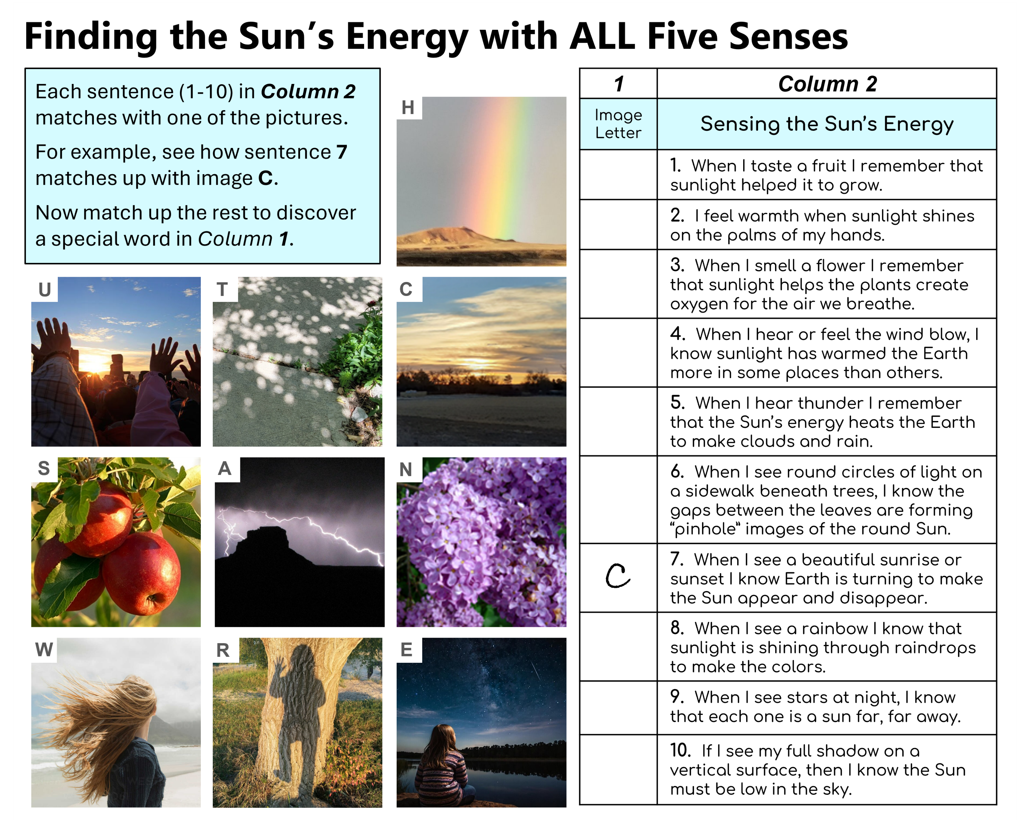



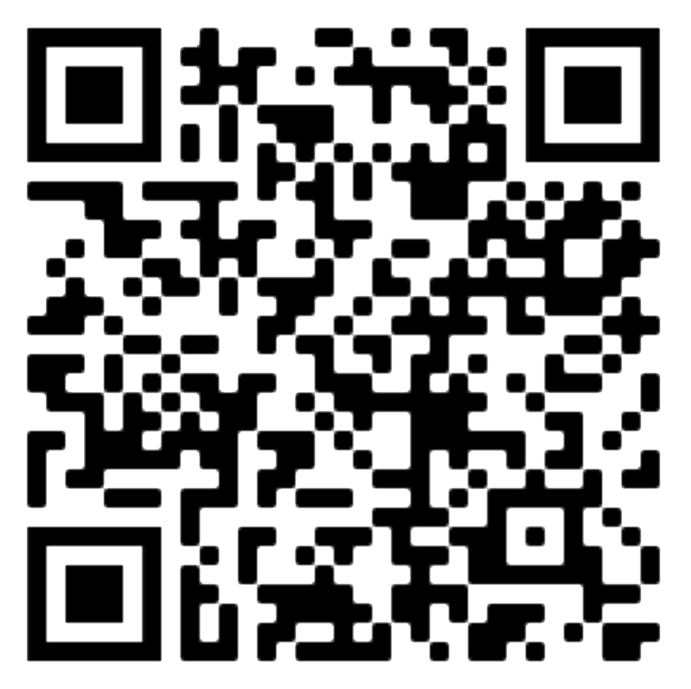
NAME: _________________________________
Your
Logo
Here
tinyurl.com/PUNCHOutreach

